Slide 1

多米体验课，We are back, And Are you coming?
听说你玩 “王者”，Do you want to create your own “荣耀”. I believe Dom Tech is Your choice
多米科技 ~Dom Tech
Pay your Taxi
Expense
Understand
company
requirements
Experience VR
I want In
Corps:
Tencent
0315-2172239
Funplus
QQ: 3234269255
Just Three days
Zeus Ent
Create your Own
mobile game
Dom Tech
www.domschool.cn
地址：高新区大陆阳光102楼705室

Slide 2

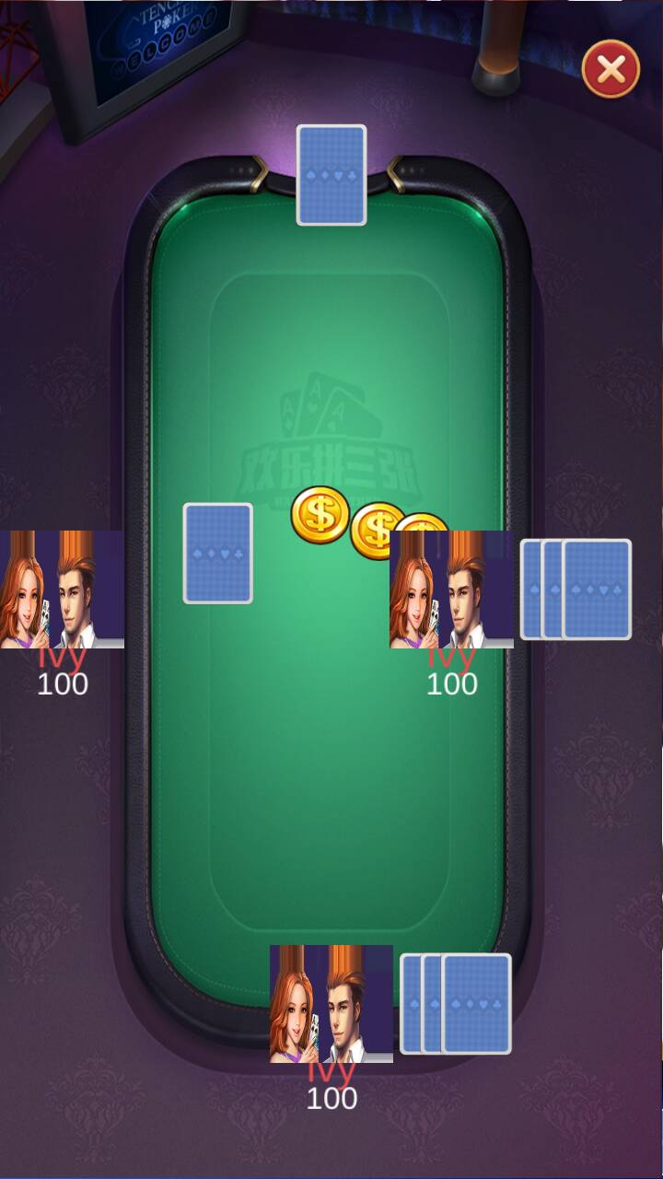
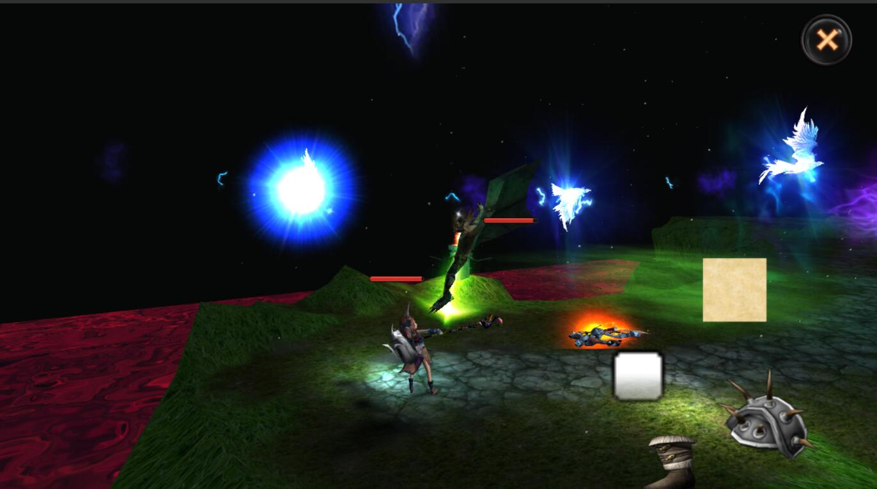

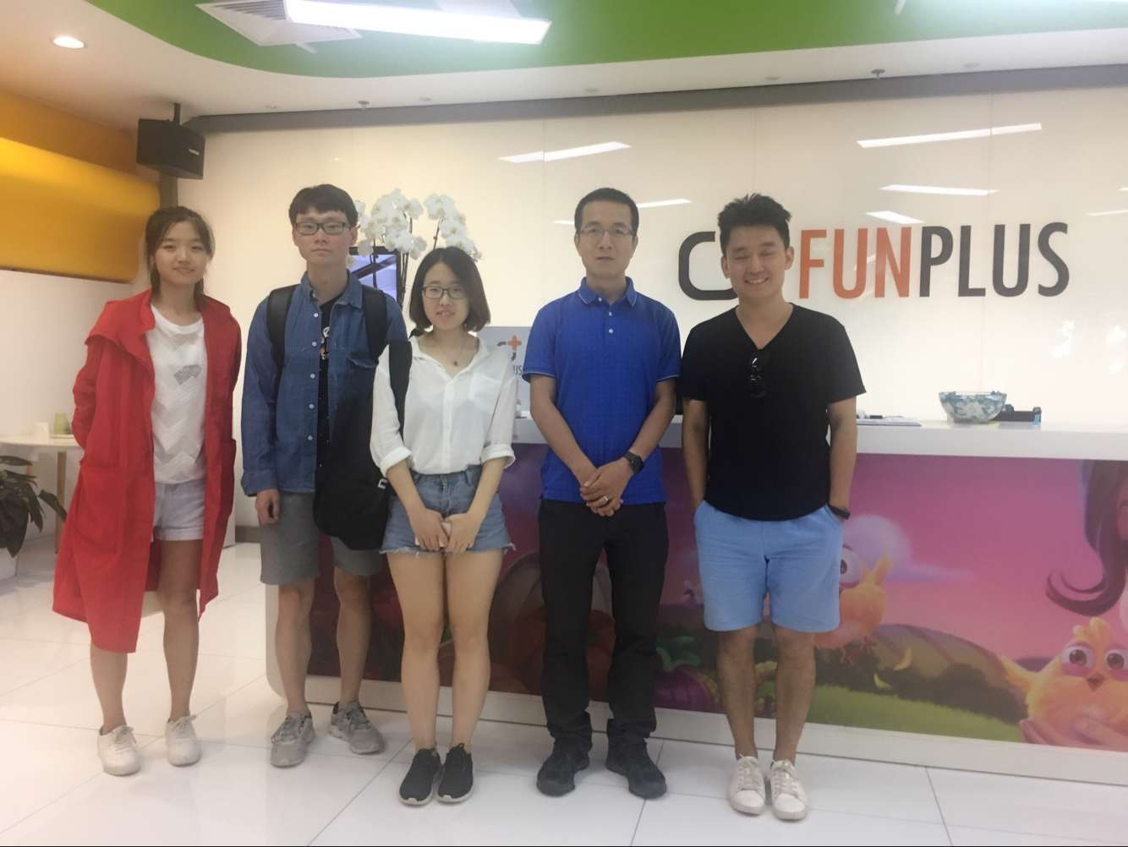
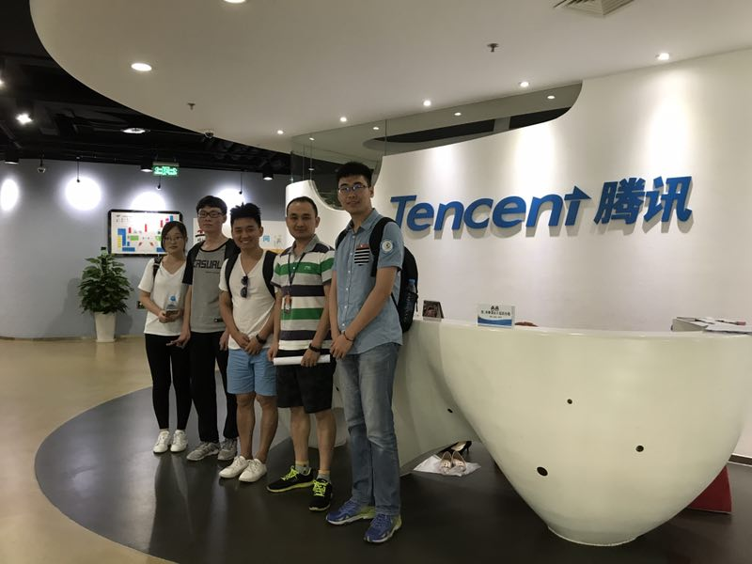
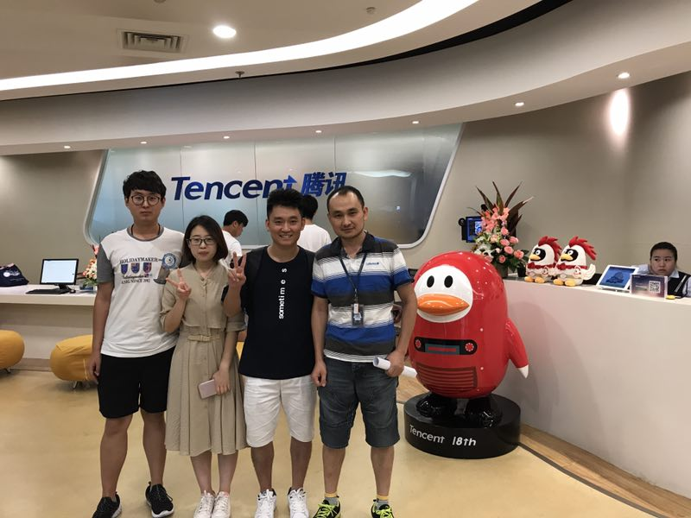
Dom Tech
多米科技
Share
Create
Learn

